Slide 1
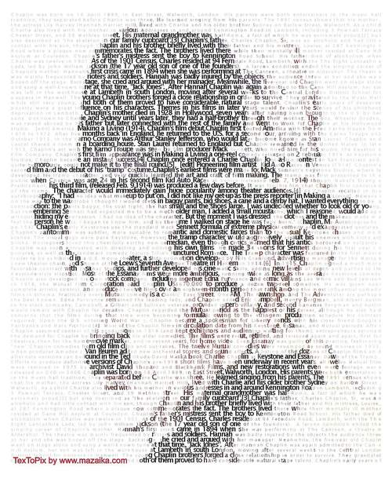

IMAGE
STEGANOGRAPHY

Slide 2
INTRODUCTION TO
IMAGE STEGANOGRAPHY
Image steganography is the practice of hiding secret information within digital images. This technique exploits the redundancy in image data, such as the least significant bits (LSBs) of pixel values, to embed hidden messages without noticeably altering the image's appearance.

Slide 3

AGENDA
The agenda of this project to send a secret text to higher officials using the steganography concept and RGB technique, ensuring that criminals or others cannot identify the image or its hidden content. Thos project will involve encoding the secret text into the least significant bits of the image’s pixels, making the alterations imperceptible to the human eye.

Slide 4
What is Image Steganography
Hiding Data
Invisible to the Eye
Secured
Communication
Image steganography involves embedding secret data, such as text, images, or even files, within the pixels of a digital image.
The hidden data is concealed in a way that it is undetectable to the casual observer, making the image appear normal and unaltered.
This technique allows for secure communication, as the existence of the hidden data is hidden from anyone who is not aware of its presence.

Slide 5
Least Significant Bit (LSB) Insertion : One of the most straightforward and widely used techniques in image steganography. This method involves modifying the least significant bits of the pixels in a digital image to encode hidden information.
Here’s a detailed look at how LSB steganography works:
Image Pixels:
Digital images are composed of pixels, each represented by bits.
In a grayscale image, each pixel can be represented by 8 bits.
In a color image (like RGB), each pixel is represented by 24 bits (8 bits for red, 8 bits for green, and 8 bits for blue).
Least Significant Bit:
The least significant bit is the lowest bit in a byte. For example, in the byte 10110101, the least significant bit is the rightmost one (1).
Embedding Process:
To hide information, the least significant bit of each pixel’s color value is altered to match the bits of the secret message.
Example: If a pixel's red value is 11001010, and the secret message bit is 1, the red value is changed to 11001011.

Slide 6
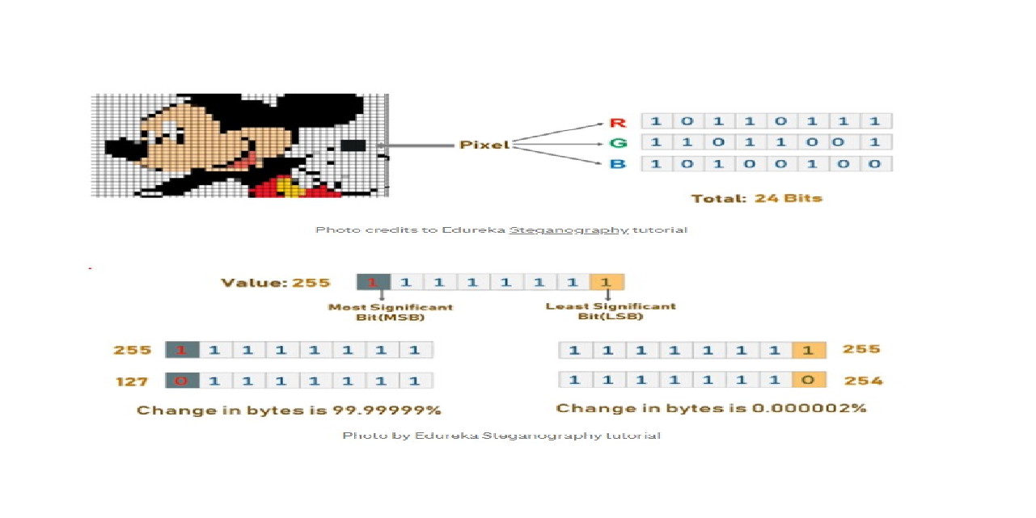
4. Extracting Process:
The hidden information can be extracted by reading the least significant bits of the pixels in the same order they were modified.

Slide 7
WHO ARE THE END USERS OF THE PROJECT?
The primary end users for this steganography project include government and military personnel secure communication, corporate executives protecting proprietary data, and journalists sharing sensitive information discreetly.
IT and cyber security teams can integrate this technique to enhance organizational data security.
Additionally, the person who wants to send any secret message other person in a hidden format then this project will helpful for them.

Slide 8
YOUR SOLUTION AND ITS VALUE PROPOSITION
Steganography is the basic concept to hide the data inside other data.
In this project RGB Mechanism is used for pixel manipulation.
XOR operation is used for encryption and decryption of the test inside the image.
The project reads an image and hides the secret text within the pixel values using the least significant bits (LSB) method.
For security purpose that means to avoid unauthorized users taking the advantage of the message, a secret key used to hide and unhide the data.
Finally, By using this project we can hide the data inside an image using secret key and for unhide the message secret is used.

Slide 9

Implementing Image Steganography with Python
1
Image Manipulation
Using Python's image processing libraries, such as Pillow, you can read, manipulate, and save image files.
2
Data Embedding
Algorithms are used to encode the secret data into the image's pixels, ensuring it remains invisible.
3
Decoding and Extraction
Complementary algorithms are employed to extract the hidden data from the image, reverting the steganographic process.

Slide 10




Demonstrating the Project with Sample Images
Input Image
Hidden Data
Output Image
Data Extraction
An image used to hide the secret data.
The information that will be embedded within the image.
The image with the hidden data, indistinguishable from the original.
The process of retrieving the hidden data from the output image.

Slide 11
LIBRARIES
Pillow: For image manipulation.
Pillow: For image manipulation.
OpenCV: For advanced image processing.
INSTALL
NumPy: For numerical operations.

Slide 12
MODELLING
ENCODING PROCESS:
Load the image.
Convert the message into binary format.
Modify the image's pixel values to encode the message.
DECODING PROCESS:
Load the encoded image.
Extract the binary data from pixel values.
Convert binary data back to the original message.

Slide 13
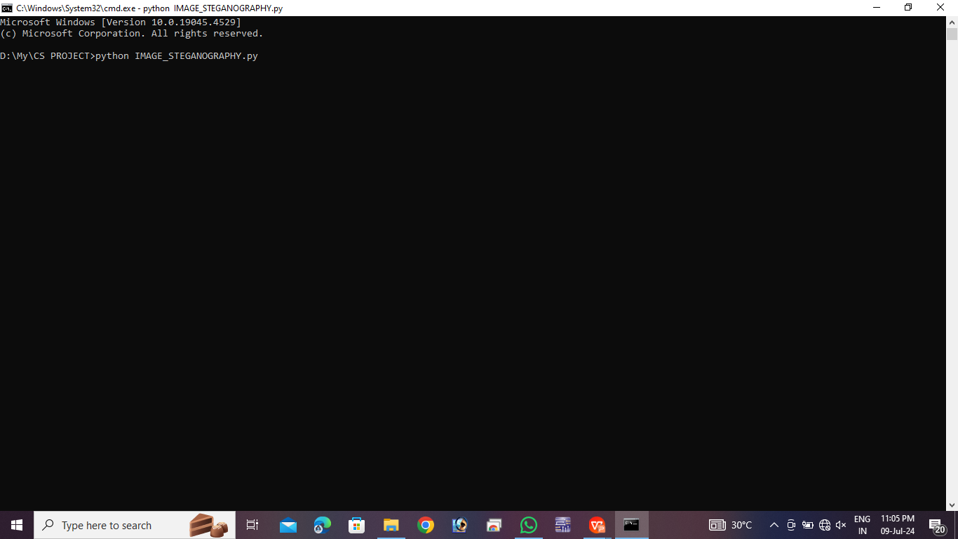

RESULT

Slide 14


ORIGINAL IMAGE
ENCODED IMAGE
DECODED MESSAGE : BHARAT MATA KI JAI

Slide 15
Certificate: https://drive.google.com/file/d/1NB9ezjx3wk5NgBfxqisG-rnTo5N6WyCa/view?usp=drive_link

Slide 16
THANK YOU

